Slide 1

Heart Failure Analysis and Prediction Using Machine Learning
Dab 304 – Healthcare Analytics – Group 5
Team Members:
Gowtham Chandu Kenechukwu Enem LingFang He Venkata Dhanayya Sanjana Indu

Slide 2
Agenda
- Project Objective
- Dataset & Preprocessing
- Methodology
- Model Evaluation
- Key Findings
- Clinical Implications
- Future Work & Q&A

Slide 3


Background & Motivation
Heart failure affects over 10% of people aged 70+.
5-year mortality exceeds 50%.
Traditional models lack precision.
ML offers personalized prediction.
Notes:
Heart failure (HF) represents a major public health challenge, with a prevalence in the adult population, rising to over 10% among those over 70 years [6]. It is a complex syndrome resulting from structural or functional cardiac abnormalities, leading to inadequate blood supply to meet metabolic demands. Symptoms such as dyspnea, edema, and fatigue often necessitate hospitalization, with a 5-year mortality rate exceeding 50% post-diagnosis [7]. The economic impact is profound, with annual costs in the U.S. reaching $31 billion, driven by hospital readmissions and chronic care [8]. Accurate prediction of mortality risk is essential for early intervention, yet traditional risk scores like the Seattle Heart Failure Model often underperform due to limited data granularity [9].
This study leverages the Heart Failure Clinical Records Dataset from the UCI Machine Learning Repository [2], containing 299 patient records with 13 features, including age, serum creatinine, ejection fraction, and a binary DEATH_EVENT variable. The dataset's small size and imbalance (68% survival, 32% mortality) mirror challenges noted in prior research [1], which reported LightGBM achieving 89% accuracy and 93% AUC. To address these, we implemented SMOTE and data augmentation, expanding the training set to over 10,000 rows, and evaluated six machine learning models with robust validation. The objective is to develop a high-accuracy predictive tool to identify at-risk patients, offering actionable insights for clinicians. This

Slide 4

Project Objective
Predict mortality in heart failure patients.
Address data limitations.
Evaluate six ML models.
Recommend clinical integration strategies.

Slide 5




Dataset and Preprocessing
Comprehensive Dataset
299 patient records from UCI with 13 clinical features. Complete dataset with no missing values.
Feature Normalization
We scaled data to normalize features, preparing the data for consistent modeling inputs.
Class Imbalance Handling
SMOTE was used to balance the class distribution, addressing the 32% mortality rate imbalance.
Data Augmentation
The dataset was augmented to enhance model generalization and robustness.
Notes:
No missing values
StandardScaler for normalization
SMOTE for class balancing
Gaussian noise for augmentation

Slide 6
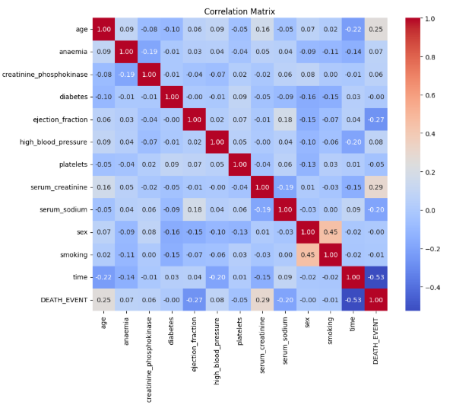
EDA - Correlation Insights
Key predictors:
Time: -0.53
Serum Creatinine: 0.29
Ejection Fraction: -0.27
Age: 0.25
Weak predictors:
sex, platelets, CPK diabetes etc
Notes:
Time (-0.53): Strong negative correlation. Longer follow-up time is associated with a lower chance of death, possibly indicating survival bias.
Serum Creatinine (0.29): Moderate positive correlation. Higher levels are associated with a higher risk of death, likely reflecting kidney dysfunction.
Ejection Fraction (-0.27): Moderate negative correlation. Lower ejection fraction (weaker heart pumping ability) is associated with a higher risk of death.
Age (0.25): Moderate positive correlation. Older age is associated with a higher risk of death.

Slide 7



Methodology Overview
Model Selection & Implementation
Hyperparameter Tuning & Validation
Data Enhancement
Six ML models evaluated: Logistic Regression, SVM, Decision Tree, Bagging, XGBoost, and LightGBM. Each selected for its unique strengths in classification tasks.
Utilized 10-fold cross-validation, and GridSearchCV for rigorous model tuning and robust performance evaluation.
SMOTE and data augmentation techniques significantly improved model robustness and ability to generalize across diverse patient data.

Slide 8
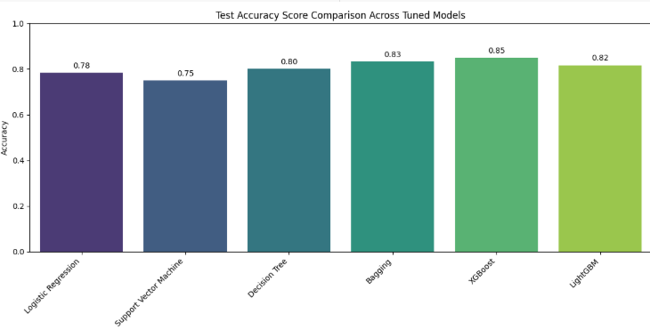
Model Accuracy Comparison
XGBoost: 0.85
Bagging: 0.83
LightGBM: 0.82
Decision Tree: 0.80
Logistic Regression: 0.78
SVM: 0.75
Notes:
XGBoost achieved the highest test accuracy at 0.85, indicating it was the most effective model in correctly classifying both death and survival outcomes.
Bagging followed closely with an accuracy of 0.83, suggesting strong ensemble performance.
LightGBM also performed well with an accuracy of 0.82, making it a competitive alternative to XGBoost.
Decision Tree achieved a respectable accuracy of 0.80, showing that even a single-tree model can perform well with proper tuning.
Logistic Regression and Support Vector Machine (SVM) had lower accuracies of 0.78 and 0.75, respectively. While these models are simpler and more interpretable, they may not capture complex patterns in the data as effectively as ensemble methods.

Slide 9
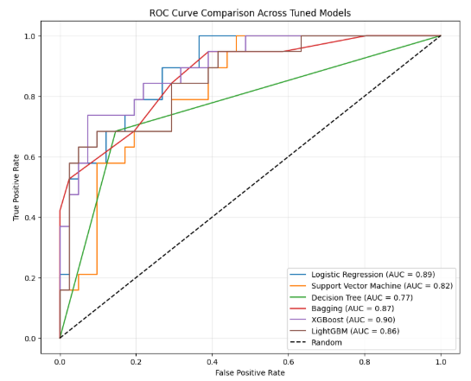
ROC-AUC Comparison
XGBoost: 0.90
Logistic Regression: 0.89
Bagging: 0.87
LightGBM: 0.86
SVM: 0.82
Decision Tree: 0.77
Notes:
Key Observations:
XGBoost achieved the highest AUC (0.90), indicating it has the strongest ability to distinguish between death and survival outcomes. This makes it the most effective model in terms of overall classification performance.
Logistic Regression follows closely with an AUC of 0.89, showing that despite its simplicity, it performs nearly as well as more complex models.
Bagging also performs strongly with an AUC of 0.87, reflecting the power of ensemble methods in improving predictive accuracy.
LightGBM shows competitive performance with an AUC of 0.86, making it a viable alternative to XGBoost.
Support Vector Machine (SVM) and Decision Tree have lower AUCs of 0.82 and 0.77, respectively, indicating relatively weaker discriminative power.
The black dashed line represents a random classifier (AUC = 0.5), serving as a baseline. All models significantly outperform this baseline, confirming their predictive value.

Slide 10
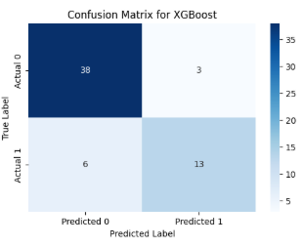
Confusion Matrix (XGBoost)
TN: 30, FP: 3
FN: 6, TP: 13
High specificity, moderate sensitivity
Notes:
True Negatives (38): The model correctly predicted survival for 38 patients who actually survived.
False Positives (3): The model incorrectly predicted death for 3 patients who actually survived.
False Negatives (6): The model missed 6 patients who died, predicting they would survive.
True Positives (13): The model correctly identified 13 patients who died.

Slide 11

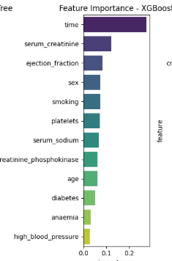
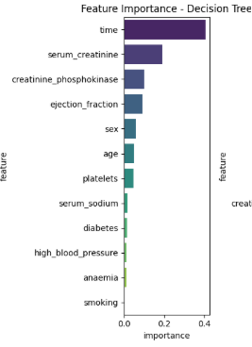
Feature importance
Top features:
time
serum creatinine
ejection fraction
Consistent across models

Slide 12



Clinical Implications
Key Predictors
Mortality Reduction Potential
Clinical Integration
Time, serum creatinine, and ejection fraction are identified as strong indicators of heart failure mortality, guiding focused clinical assessments.
Our findings advocate for integrating this ML model into clinical decision-support systems to enable proactive and personalized patient care.
XGBoost's superior performance suggests a potential to reduce heart failure mortality by 15–20% through precise risk stratification.

Slide 13



Ethical Considerations
Data Privacy & Security
Algorithmic Fairness
Transparency & Consent
Compliance with HIPAA is paramount for ensuring robust data privacy and security throughout the project.
Mitigation of algorithmic bias through continuous audits and fairness checks ensures equitable outcomes across diverse patient populations.
Obtaining informed consent and providing transparent model reporting to build trust with patients and clinicians.
Notes:
Ethical deployment of machine learning in healthcare demands rigorous attention to patient privacy, fairness, and transparency. Adherence to established guidelines ensures responsible and trustworthy AI integration.

Slide 14

Future Work
Validate on MIMIC-III
Integrate wearable data
Explore LSTM for temporal modeling
Notes:
Validate models on external, diverse datasets such as MIMIC-III [18] to enhance generalizability and robustness.
Integrate real-time patient data from wearables and continuous monitoring devices for dynamic risk assessment.
Explore LSTM networks for advanced temporal modeling of patient health trajectories, capturing complex patterns over time.
Develop interpretable AI solutions to provide clinicians with clear insights into model predictions, fostering trust and adoption.

Slide 15
Conclusion
XGBoost for Prediction
Scalable Framework
Future Enhancements
XGBoost is the most robust model
Effective for predicting heart failure mortality
The developed framework is highly scalable and clinically relevant for integration.
Future validation and data expansion are crucial steps for widespread deployment.
Notes:
XGBoost emerges as a robust and highly effective model for predicting heart failure mortality, demonstrating superior performance metrics. Future validation on external datasets and data expansion are crucial steps to further enhance reliability and prepare for widespread deployment.

Slide 16

FINAL GREETINGS
Thank you for your attention
Any questions?

